Slide 1
Representing Manufacturing Capabilities
Farhad Ameri
April 2018, University at Buffalo

Slide 2
Outline
Part I
Manufacturing capability definitions and types
Part II
Manufacturing capability terminology
Part III
CaMDiF project (capability modeling for digital factory)

Slide 3
Understanding and representing manufacturing capabilities: why it matters?
Building manufacturing partnerships
Supply chain formation
Outsourcing
Design for manufacturability
Creating feasible designs based on the available capabilities
Strategic planning
Where the company is now in terms of capabilities and where it wants to be in future to better compete in the market.

Slide 4
Capability in the context of Business Strategy

Slide 5
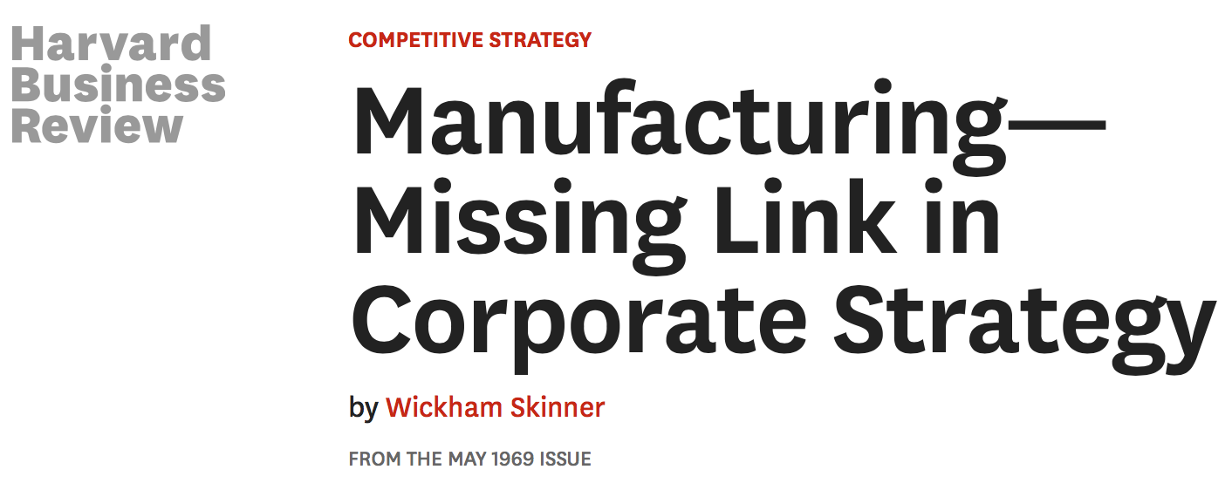
Competitive priorities of firms
The term `capabilities’ entered the manufacturing strategy literature from the business strategy field following Skinner’s works in the 60’s.
Notes:
Manufacturing capability was first studied in the context of manufacturing strategy by Skinner at Hayward University

Slide 6
Corporate Strategy: Bottom-up vs. top-down
Quality
Cost-efficiency
Dependability
Flexibility
Competitive priorities
Competitive priorities
Capabilities
Capabilities
Functions
Functions
Resources
Resources
Bottom-up
Top-down

Slide 7
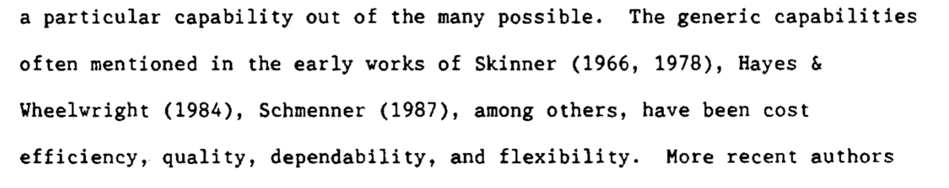
Generic Manufacturing Capabilities
Excerpt from: Ferdows, Kasra, and Arnoud De Meyer. "Lasting improvements in manufacturing performance: in search of a new theory." Journal of Operations management 9.2 (1990): 168-184.

Slide 8
Generic Manufacturing Capabilities
Quality (conformance quality):
The `degree to which a specific product conforms to a design or specification’.
Flexibility
the ability to instigate rapid design changes and rapid volume changes
Dependability
Delivery dependability: the ability to deliver product to the customer on-time (delivery dependability).
Service dependability: the ability to provide effective after-sales services
Cost-efficiency
The ability to manufacture low-cost products
Innovation
the ability to develop and introduce new products successfully

Slide 9
Capability Pyramid
Cost-efficiency
Quality
Dependability
Flexibility
Innovation
Competitive priorities
Core competencies
Strategic capabilities
Lower-level capabilities
Notes:
Teece et al. (1997, 516) defines dynamic capabilities “the firm’s ability to
integrate, build, and reconfigure internal and external competencies to address
rapidly changing environments”.

Slide 10
Models of capability development
Two competing schools of thought:
Trade-off Model
Cumulative Model
Achieving competitive strength along one of these yardsticks [competitive priorities] should come at the expense of the rest (Skinner, 1969).
Lasting capabilities are not built at the expense of each other, but upon each other, following a specific pattern (Hayes & Wheelwright, 1985, Nakane, 1986).

Slide 11
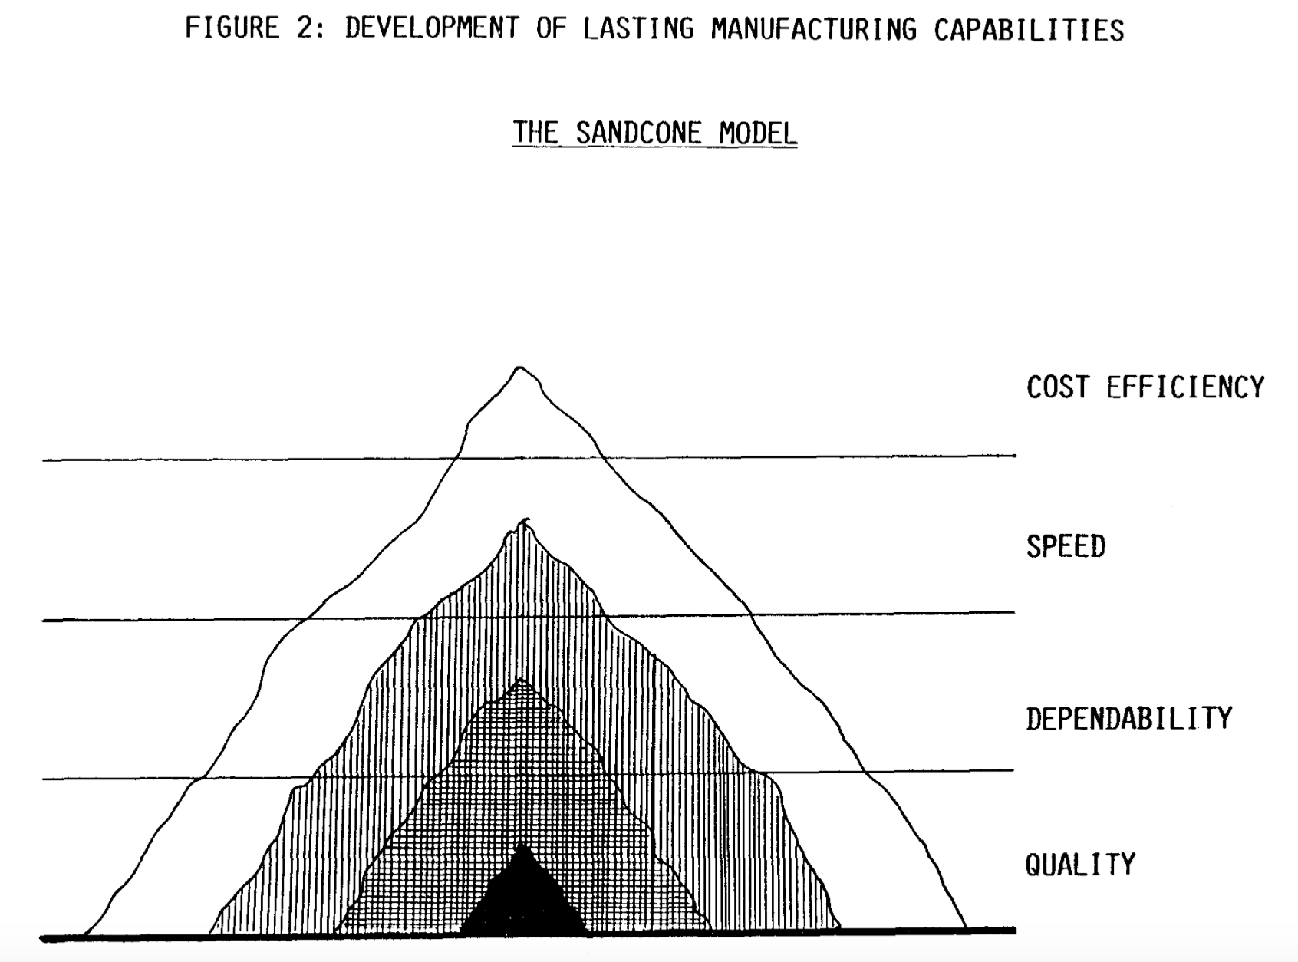
Cumulative (Sandcone) Model
Hayes & Wheelwright, 1985,
[of reaction]
Notes:
lasting capabilities are not built at the expense of each other, but upon each other, following a specific pattern of quality, followed by dependability, then reaction speed and finally cost efficiency.
one capability is built upon another, not in its place.

Slide 12
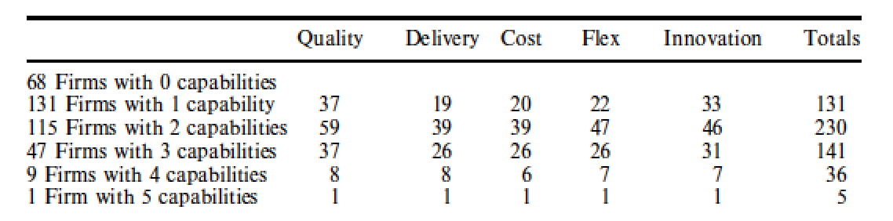
Manufacturing Futures Survey
371 companies studied over 11 industries
Corbett, L. M., and G. S. Claridge. "Key manufacturing capability elements and business performance." International Journal of Production Research 40.1 (2002): 109-131.

Slide 13
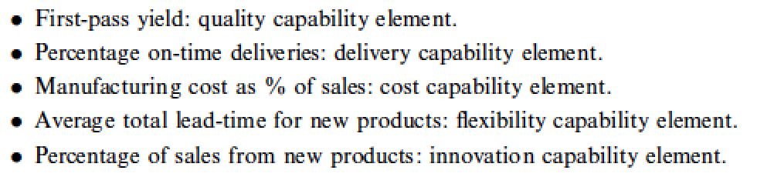
Characterizing capabilities (Performance measures)

Slide 14
How Many?
Supporting and nurturing more than four core competencies may prevent a firm from developing the focus needed to fully exploit its competencies in the marketplace.
Corbett, 2002
Notes:
Example: Walmart

Slide 15
Capability in the context of Resource-based View of the firm

Slide 16
Capabilities and Resources
Capabilities were studies in conjunction with resources following the development of the resource-based view (RBV) of the firm.
Resources
A firm is a ….
Capabilities
That can be used to create a unique market position
bundle of heterogeneous
Competencies
Notes:
The term `capabilities’ has come into the manufacturing strategy literature from
the business strategy field, particularly following the development of the `resource-based’
view (RBV) of the firm.
Resource Perspective – suggests that a firm possesses at least some resources and capabilities that other companies do not, at least not in the same combination

Slide 17
Key Terms
Resources
Resources are assets (tangible or intangible) the firm has to work with, including its equipment, people and the value of its brand name.
Capabilities
Firm's capacity to deploy resources that have been purposely integrated to achieve a desired end state (Nanda,1996).
Competencies
The capabilities that serve as a source of competitive advantage for a firm over its rivals.
Distinctive capabilities that allow a company to stand out
Notes:
Core Competencies – Core competencies distinguish a company competitively from its rivals and reflect the personality of the organization.
Discussion points:
Emerge over time through the organizational process of accumulating and learning to deploy resources and capabilities
The “crown jewels of a company” – activities the firm performs especially well compared with competitors
Strategic assets – resources and capabilities with a competitive value and potential to provide a competitive advantage
Success comes from identifying opportunities in the environment that can be exploited through core competencies, while avoiding competition in areas of weakness

Slide 18
Resources, Capabilities, and Core Competencies
Resources are the source of a firm's capabilities.
Capabilities arise from the possession of resources (assets) (Grant 1991)
capability is the ability to apply resource(s) to do something
Capabilities, in turn, are the source of a firm's core competencies.
A firm's core competencies are the basis for its competitive advantages in the marketplace.
Create/enable
become
drive
Resources
Capability
Core competency
Strategic competitiveness
Notes:
Resources, Capabilities, and Core Competencies
Discussion points:
Are not inherently valuable, but they create value when the firm uses them to perform certain activities that result in a competitive advantage
Should be used to simultaneously achieve operational effectiveness and uniqueness
Operational effectiveness – able to do what competitors do, but better – signals that the firm is using its resources and capabilities efficiently relative to competitors
Unique strategic position – creates value by doing things differently or by doing different things than competitors – implementing a strategy which takes advantage of that position is required to consistently create value for stakeholders over the long-term
What are some measures of operational effectiveness?
Productivity
Quality
Speed
What types of management techniques are available in the quest for operational effectiveness?
TQM
Benchmarking
Time-based competition
Re-engineering

Slide 19
Competencies
Competencies are the capabilities that meet the four criteria of sustainable competitive advantage and have strategic relevance.
Valuable
Allow the firm to exploit opportunities or neutralize threats in its external environment
Rare
Possessed by few, if any, current or potential competitors
Costly-to-imitate
Cost for other firms to develop is prohibitive, cannot be developed easily by other firms
Non-substitutable
Do not have strategic equivalents

Slide 20
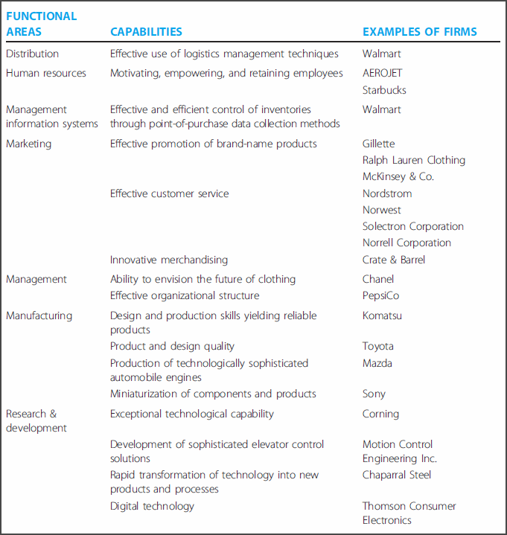
An ability to use logistic management techniques Ability to motivate employees
An ability to control inventory
An ability to promote brand name
An ability to provide customer service
An ability to implement innovative merchandising
An ability to envision the future of clothing
An ability to design and manufacture reliable products
An ability to design and manufacture high quality products
An ability to manufacture sophisticated engines
An ability to miniaturize components
An ability to develop sophisticated elevator control solutions
An ability to use digital technology
Notes:
Table 4.3: Examples of Firm’s Capabilities – Capabilities are often developed in specific functional areas or in a part of a functional area (for example, advertising within the marketing department). Research suggests that a relationship exists between capabilities developed in particular functional areas and the firm’s financial performance at both the corporate and business-unit levels, suggesting the need to develop capabilities at all levels.
The capabilities included in this table satisfy the Four Criteria of Sustainable Competitive Advantage discussed on Slides 21 and 22.

Slide 21
Some Observations
Capabilities are often treated as abstract entities whose specific meaning always depends on the context.
The term ‘competence’ is used synonymously as capability
The distinction between ‘capabilities’ and ‘resources’ is not definite.
No clear distinction between ‘knowledge’ and capability.
Capabilities are often defined vaguely.
The ability of an organization to perform a coordinated set of tasks (Helfat, 2003
Socially complex routines that enable an organization to …. (Collis, 1994)
Intermediate transformationability between resources and objectives (Dutta, 2005)

Slide 22
Attributes of capabilities (as defined in the literature)
Capabilities are treated as “potentials” and “capacity”.
Capabilities can be measured.
Capabilities are linked to resources.
Capabilities endure in time and evolve over time.
Consistent with BFO: Disposition

Slide 23
Types of capability

Slide 24
Capability Pyramid
Second-order capabilities
(dynamic capabilities)
[ capabilities for gaining new capabilities or combining existing capabilities ]
First-order capabilities
(operational capabilities)
[ capabilities for core everyday business ]
Market
capabilities
Technology capabilities
…..
Notes:
Teece et al. (1997, 516) defines dynamic capabilities “the firm’s ability to
integrate, build, and reconfigure internal and external competencies to address
rapidly changing environments”.
Creation, modification, and combination of lower-level capabilities

Slide 25
Types of operational capabilities
definition
[ The ability of a firm to serve/communicate with customers ]
Market Capability
definition
[The ability of a firm to design and manufacture certain physical products in certain volumes ]
Technology Capability
Design Capability
Production Capability
fabrication Capability
…...

Slide 26
Fabrication Capability
Fabrication Capability
[ The ability of a manufacturing entity to modify the properties of input objects]
Is-a
Is capability of a
Machining Capability
[machine tool, machine cell, factory ]
complexity capability
What is the level of complexity of the parts that can be machined?
What is the dimensional accuracy of the parts that can be machined?
What is the best surface finished that can be generated through machining?
What is the length of the biggest part that can be machined?
What is the diameter of the smallest hole that can be machined?
What are the material types that can be machined?
What is the average tool change time during machining?
precision capability
Surface roughness capability
dimension capability
Feature size capability
material capability
Speed capability

Slide 27
Vertical dependency
Precision Capability
Reliability Capability
Factory
Machine Cell
Machine
device
Notes:
Capability of the higher-level resources depends on the capability of lower-level resources.

Slide 28
Part II
Manufacturing capability terminology
Research Questions
How contract manufacturers advertise their capabilities?
What types of capabilities are emphasize more?
What terms and phrases do they use?
What are the capability jargons?

Slide 29
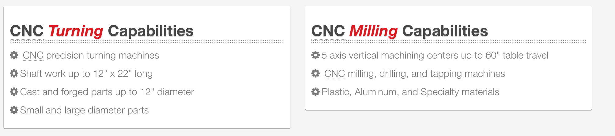
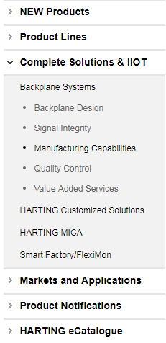

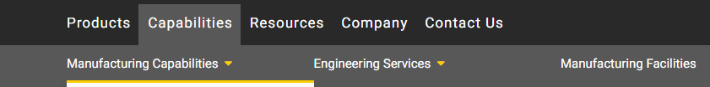
Capability representation on company website

Slide 30
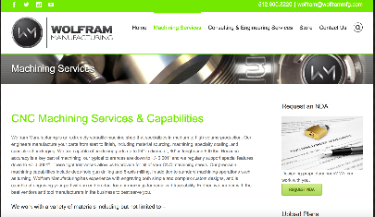
Precision machining
Complex shapes
Heavy parts
Exotic materials
Medical industry
5-axis machining

Slide 31
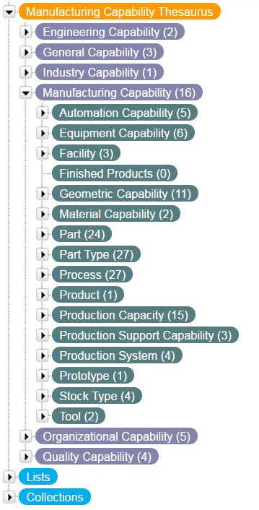
Manufacturing Capability Thesaurus
A SKOS thesaurus was developed based on a dataset composed of 500 manufacturing companies in precision machining industry (training data).
About a 1000 terms/phrases were collected
762 Preferred Labels
207 Alternative Labels
Organized into 5 categories

Slide 32
Manufacturing Capability > Production Capacity
Synonym

Slide 33
Manufacturing Capability > Part Type
The ability to manufacture …
Related
Synonym

Slide 34
Manufacturing Capability > Geometric complexity
The ability to create …
Broader Term

Slide 35
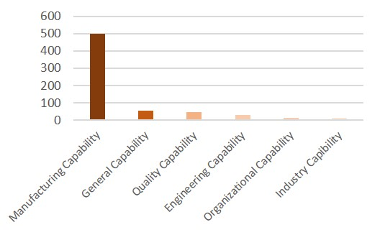
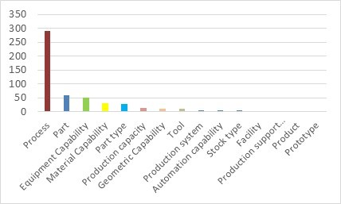
Term frequencies in the corpus

Slide 36
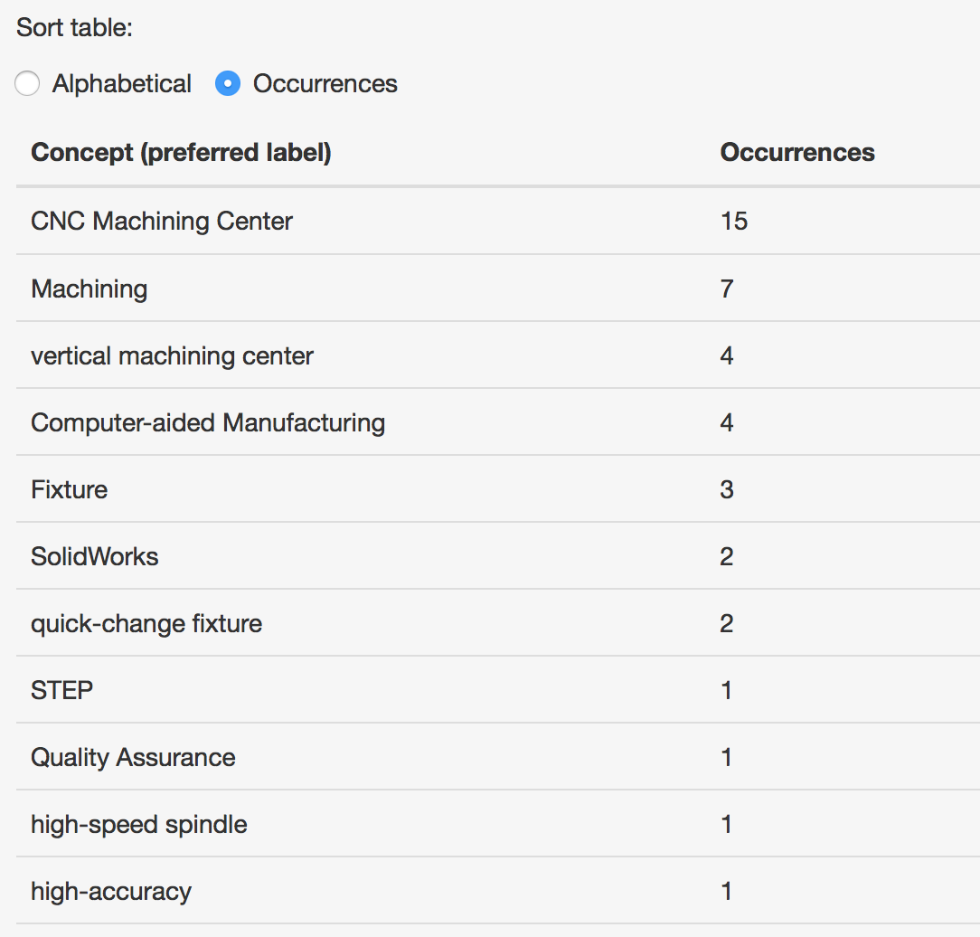
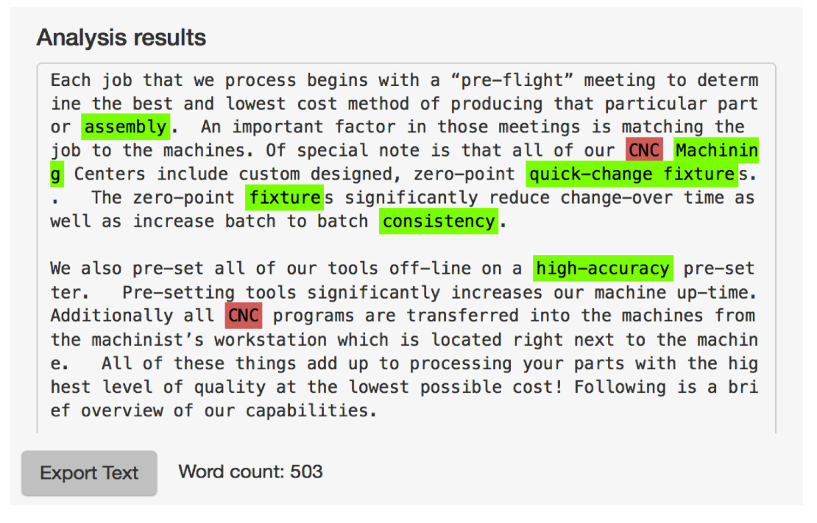
Entity Extractor Tool

Slide 37
Lessons learned
Technology capabilities are highlighted more than other types of capabilities
Parts, processes, materials, equipment, and facilities are the main features of capability for most contract manufacturers.
Organizational capabilities are only emphasized by larger companies
Human skills
Certifications
Use of industry jargons is common among contract manufacturers (CM) when describing capabilities

Slide 38
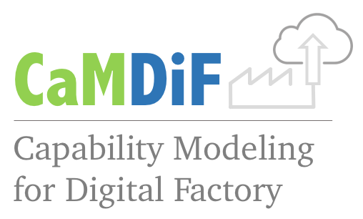
Part III

Slide 39
Problem Statement
Supply chain formation is mainly a manual process supported by traditional tools and methods.
There is a need for:
Increasing the intelligence and level of automation of sourcing and supply chain formation decisions using ICT.
Increasing the speed and accuracy of the deployment and customization of agile supply chains.

Slide 40

Objectives
Developing a formal ontology for representing manufacturing capability to enable semantic interoperability throughout the supply chain.
The ontology is based on MSDL (Manufacturing Service Description Language ).
It is BFO-conformant
Creating Digital Factories as ontological representation of physical factories
Analyzing, quantifying, and visualizing the capabilities of Digital Factories
Enabling automated inference and reasoning about manufacturing services and capabilities.
Capability 1
Capability 2
Capability 3
Capability 4
Capability 5
poor
excellent
From Physical Make-up
To Capability

Slide 41


Goals & Objectives
What will this project do to solve the problem identified in the previous slide?
Cloud
Cloud
Convert the physical factory to …
Digital Factory
Described by …
Formal ontology
Cloud
Created using …
DiFacto
Intuitive, visual GUIs
Cloud
DiFacto
Cloud
DiFacto
Cloud
DiFacto
Matching
Comparing
Merging
Cloud
DiFacto
Connected to …
Resource Libraries
Semantic Reasoning Algorithms
Supply Chain Configuration

Slide 42
CaMDiF Functions
Build
Analyze
Match

Slide 43
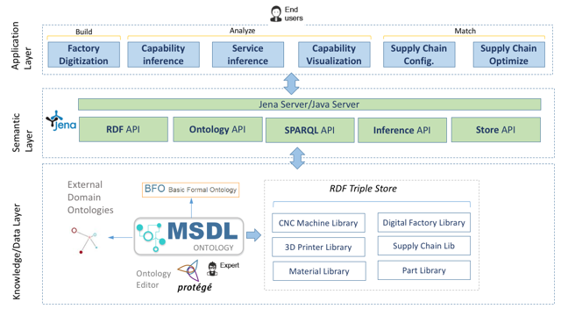
System Architecture

Slide 44
Detailed Technical Progress : MSDL to BFO mappings
BFO : specifically dependent continuant
BFO : material entity
BFO : realizable entity
BFO : disposition
Organization
BFO : Role
Manufacturing Company
Supplier
operates
has role
Customer
Production System
BFO : independent continuant
human
BFO : material entity
Factory
BFO : object aggregate
has part
method
IAO : information content entity
Production software
IAO : information content entity
Raw material
BFO : material entity

Slide 45
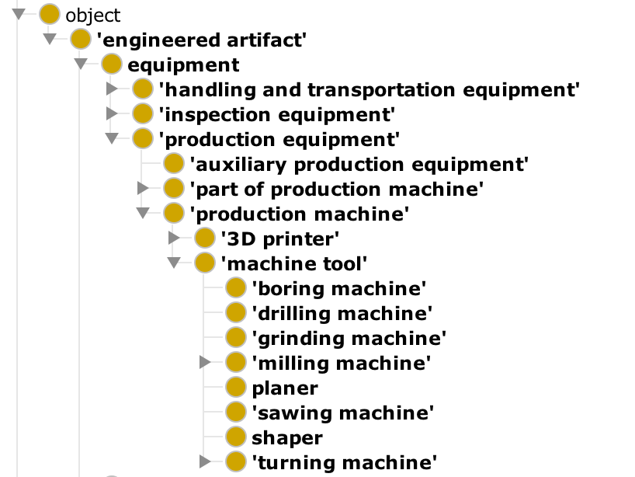
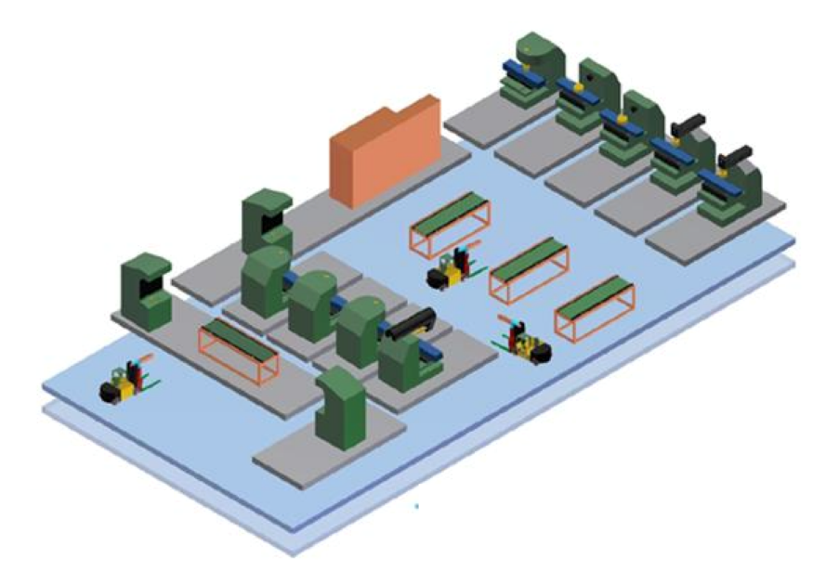
Detailed Technical Progress : Factory
BFO : object aggregate
🀰 RO : has part
Factory
Work cell 1
Work cell 2

Slide 46
Surface Roughness Capability
BFO : capability
Surface Roughness Capability
IAO : Measurement Datum
Is capability measured as
length measurement datum
Has measurement value
(xsd:float)
Has measurement unit
(micro-inch)
Surface roughness is measured as the average deviation (plus or minus) from the nominal surface (measured in micro-inch)

Slide 47
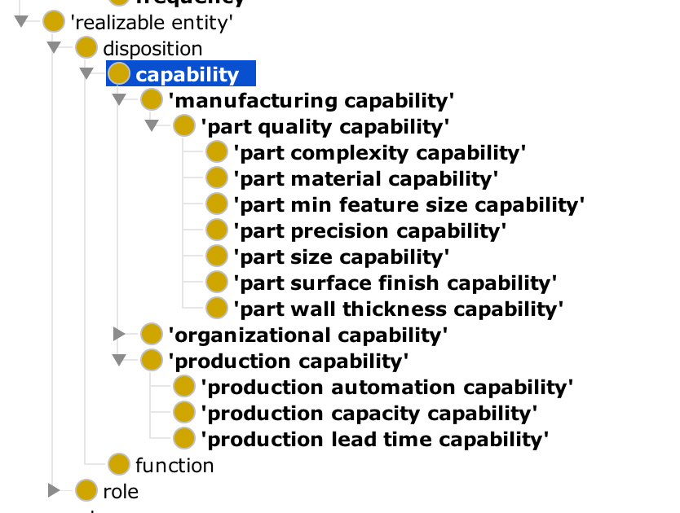
Manufacturing Capability
BFO : occurrent
BFO : occurent
BFO : process
BFO : process
Mfg service
Occurrent part of
Mfg process
Has specified output
component
BFO : quality
Has quality
Surface roughness
“Part surface finish capability” is an ability realized through a manufacturing process

Slide 48
Part Quality Capability
MSDL : manufacturing capability
MSDL: Part quality capability
Production Machine
Has part quality capability
Part complexity capability
(low-med-high)
Part weight capability
(max)
Has material capability
Part diameter capability
(min/max)
material capability
Part length capability
(min/max)
Part min wall thickness capability
(upper / lower)
Has process capability
Part tolerance capability
(exact)
manufacturing process capability
Part surface finish capability
(min/max)
Part feature size capability
Part min feature size capability
Part hole depth capability
Part min aspect ration capability

Slide 49

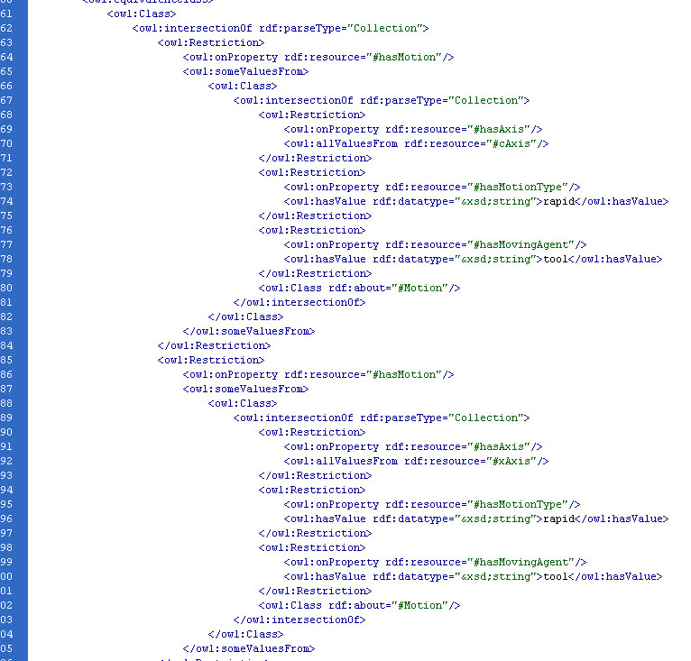
Machine-understandable capability model
Capability Model
Machine Agent
MSDL

Slide 50
Software Demo

